Slide 1

OOCSS & Oxygen CSS

Slide 2

OOCSS
Seperation of skin and structure
Seperation of context and content
?
Object Oriented
2009

Slide 3
A css object is any repeating visual pattern, which can be abstracted into a snippet of html, css, and sometimes javascript.
The goal of Object Oriented CSS is to encourage code reuse for faster and more efficient stylesheets that are easier to maintain.

Slide 4
Separation of Skin & Structure
Skin:
Font, color, Shadows, Gradients
Structure:
Width, Height, Margin, Padding, Overflow

Slide 5
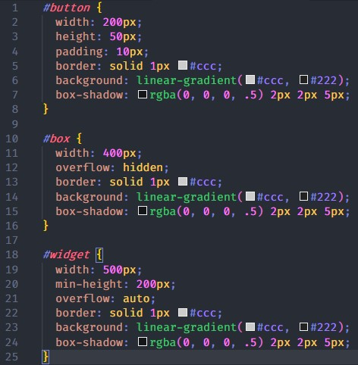
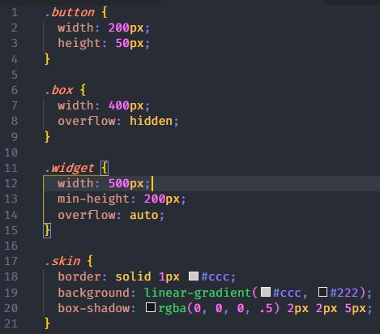
Separation of Skin & Structure

Slide 6
Separation of Context & Content
Never mimic the structure of your HTML in CSS.
Avoiding child selectors
As a general rule, styles should never be scoped to particular containers.

Slide 7
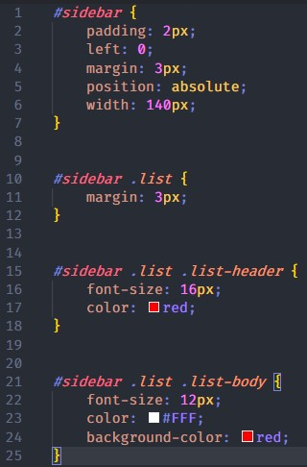
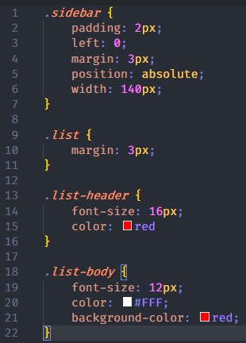
Separation of Context & Content

Slide 8
Pros & Cons
✓ High reusability
✓ Ease of maintainability
Can be confusing for new developers. What is an object and what is not? This will force you to document things and introduce new dev to your codebase (which is good to do).
As there is much more separation in the way classes are created, you may need to add multiple classes to an element to account for all of the styling elements. This can cause some confusion to those who aren’t familiar with OOCSS and can clutter your markup.

Slide 9
Oxygen CSS
2014
Object Oriented
Object
Child-Object
Modifiers
Subclasses
Voeg afbeelding toe

Slide 10
Oxygen is an object-oriented approach to CSS. It is designed to give teams a simple and consistent way to communicate about stylesheets. It is one part a set of naming conventions and one part a way of thinking about CSS. It seeks to take the best of Object-Oriented Programming and apply it to how we write CSS.
Object-Oriented code is a great fit for user interface design. We naturally speak in terms of objects when talking about “buttons”, “menus”, and “controls.” Oxygen encourages you to name these objects in your code.

Slide 11
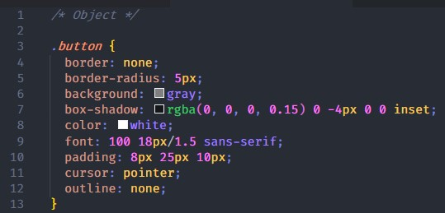
Objects
.noun
are the individual parts that make up a web page or application.

Slide 12
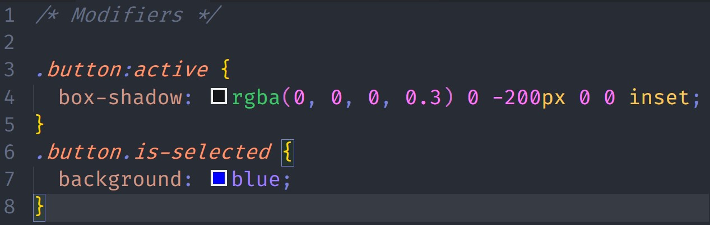
Modifiers
.prefix-adjective / .adjective
state modifiers should almost always be bound directly to the object class name

Slide 13
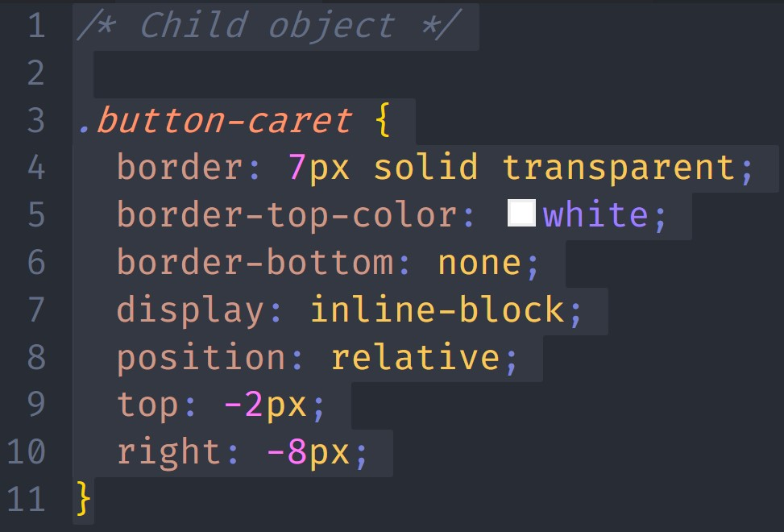
Child objects
.noun-noun
When an object should only ever be used inside of another object, the Oxygen naming convention is to include the name of the parent in the name of the child

Slide 14
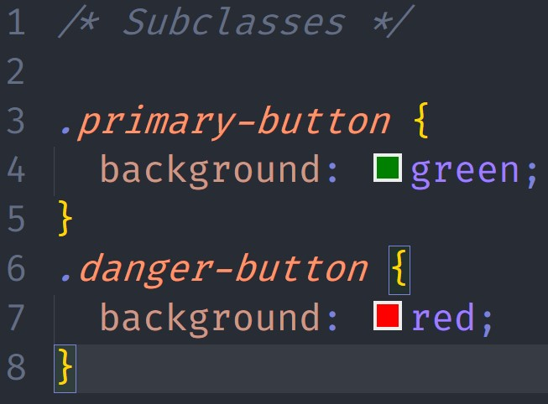
Subclasses
.adjective-noun
when an object is a kind of another object it is called a subclass.

Slide 15
Pros & Cons
✓ High reusability
✓ Ease of maintainability
Can be confusing for new developers. What is an object and what is not? This will force you to document things and introduce new dev to your codebase (which is good to do).

